Slide 1
Loan Management System with AWS

Slide 2

Introduction
Our loan management app simplifies the process for officers and customers, from application to repayment. It runs smoothly on AWS EC2 with a MongoDB database for solid performance. We use a tailored VPC and AWS Security Groups for strong security. Data safety is handled by AWS KMS, and system health is watched over by CloudWatch. IAM keeps our team's access in check. To handle lots of web traffic without hiccups, we use an AWS Load Balancer. Our setup also includes ECR for storing our Docker images, ECS for running our containerized app, Secrets Manager for keeping sensitive info safe, and WAF to protect our web app from attacks.

Slide 3
Issues with other platforms
Startups might not have enough resources to create strong platforms, resulting in systems that can’t always handle lots of users or big amounts of data. This can make the app slow or even cause it to crash when too many people try to use it at the same time.
When it comes to app features, these startups might not offer a wide range of loan options or customizations due to limited development capabilities. Also, their platforms may lack tools for analytics and reporting, which are essential for both users managing their loans and officers assessing loan applications.
On the security front, startups often struggle to implement top-notch security protocols, which is crucial for protecting sensitive financial information. They may also lack comprehensive data encryption, leaving user information vulnerable during transactions.

Slide 4
What and How?
Application Development Using Flask:
What We Did: We developed the application using Flask, a lightweight and flexible Python web framework that is well-suited for rapid development and easy integration with other services.
How We Did It: Flask allows for the creation of modular and maintainable code, which is essential for quickly adapting to changing business requirements or scaling up application features.
Database Management with MongoDB on AWS EC2:
What We Did: We used MongoDB as our primary database, hosted on AWS EC2 to leverage the user control and manageability of AWS services.
How We Did It: AWS EC2 is fully compatible with MongoDB applications, allowing us to use existing MongoDB tools and skills. It also provides the durability, scalability, and security needed for enterprise applications.

Slide 5
What and How?
Application Scalability with ECS and Load Balancer:
What We Did: To handle varying loads and ensure that our application could scale seamlessly, we deployed our Flask application on AWS ECS (Elastic Container Service).
How We Did It: ECS managed our containerized application, automatically adjusting the number of active instances according to the load. The integration with an AWS Load Balancer distributed incoming traffic across these instances, ensuring smooth performance during peak times.
Security with WAF and Security Groups:
What We Did: We secured our application by using AWS WAF (Web Application Firewall) and Security Groups.
How We Did It:
AWS WAF: This protected our app from common web exploits and attacks by defining customizable web security rules.
Security Groups: These acted as a virtual firewall for our AWS services to control inbound and outbound traffic, ensuring that only authorized traffic could access our application.

Slide 6
Loan Management Features
User Submissions:
Property Details: Users upload property type, location, valuation, and ownership documentation.
Bank Details: Users provide bank name, account number, and IFSC code.
Personal Details: Includes full name, date of birth, income, and contact info.
Loan Request & Approval:
Loan Amount: Users specify the desired borrowing amount.
Officer Review: Loan officer reviews and either approves or rejects based on risk assessment and criteria compliance.
Post-Approval Management:
EMI Payments: Users set up and make monthly installments via the platform.
Loan Tracking: Users monitor loan status, payment history, and remaining balance through a dashboard.

Slide 7
AWS Services Used
AWS EC2 MongoDB: Uses Amazon EC2 instances to run MongoDB, a NoSQL database, offering scalable and flexible data management.
AWS ECR (Elastic Container Registry): A Docker container registry that allows you to easily store, manage, and deploy Docker container images.
AWS ECS (Elastic Container Service): A container management service that allows you to run applications on a managed cluster of Amazon EC2 instances.
AWS KMS (Key Management Service): Manages encryption keys used to encrypt your data, providing security and control over keys.
AWS Secrets Manager: Helps manage, retrieve, and store secrets needed to access applications, services, and IT resources securely.
AWS WAF (Web Application Firewall): Protects web applications from common web exploits that could affect application availability, compromise security, or consume excessive resources.
AWS Load Balancer: Automatically distributes incoming application traffic across multiple targets, such as EC2 instances, in multiple Availability Zones, which increases the fault tolerance of your applications.
AWS CloudWatch: Provides monitoring for AWS cloud resources and the applications you run on AWS, enabling you to collect and track metrics, collect and monitor log files, and set alarms.
AWS Security Groups: Acts as a virtual firewall for your EC2 instances to control both inbound and outbound traffic at the instance level.

Slide 8
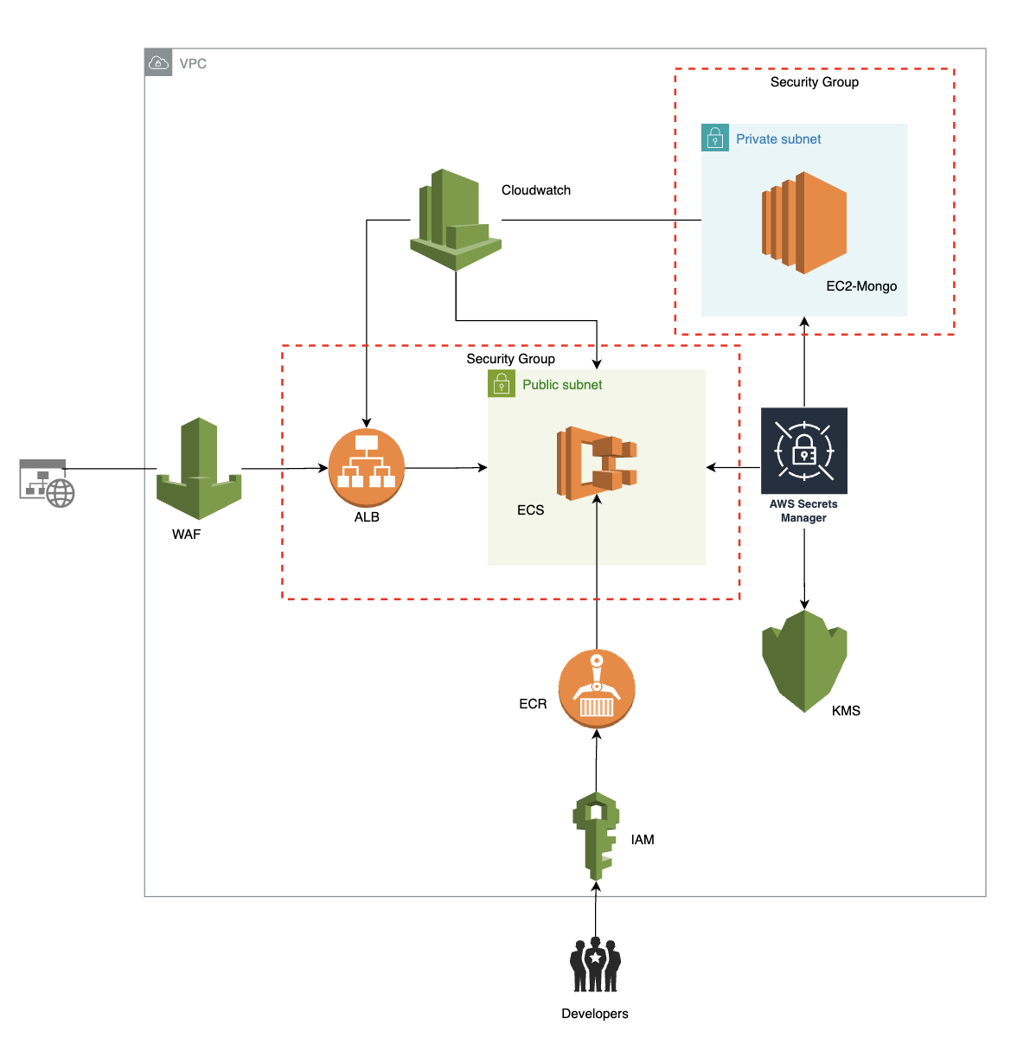
Architecture

Slide 9
Service Implementation - 1
AWS EC2 MongoDB:
Implementation: We utilized Amazon EC2 instances to deploy MongoDB, configuring these instances to handle our database requirements efficiently. The setup ensured that our MongoDB database was scalable and capable of managing the increasing data volume as user numbers grow.
AWS ECR (Elastic Container Registry):
Implementation: We began by pushing our Docker images, which include the application environment setup and dependencies, to AWS ECR. This provided a reliable and secure repository for our container images, simplifying version control and deployment processes.
AWS ECS (Elastic Container Service):
Implementation: After storing our images in ECR, we used AWS ECS to manage our Docker containers. We set up ECS services and task definitions that dictate how containers should run—such as CPU and memory usage, scaling requirements, and networking settings. This allowed our application to automatically scale based on demand, ensuring high availability and fault tolerance.

Slide 10
Service Implementation - 2
AWS Secrets Manager:
Implementation: To manage credentials and other secrets needed by our application, we utilized AWS Secrets Manager. This service helped us replace hard-coded credentials in our code with calls to Secrets Manager, which significantly reduced the risk of security leaks.
AWS WAF (Web Application Firewall):
Implementation: We deployed AWS WAF to protect our web application from common exploits and attacks by defining customizable web security rules. This setup blocked malicious traffic and prevented data breaches, ensuring the integrity and security of our application interfaces.
AWS Load Balancer:
Implementation: We configured an AWS Load Balancer to distribute incoming application traffic across multiple EC2 instances running our application. This not only balanced the load effectively but also improved the application's overall performance and resilience to potential failures.

Slide 11
Service Implementation - 3
AWS KMS (Key Management Service):
Implementation: We integrated AWS KMS to manage encryption keys for our sensitive data, such as user personal information and financial details. KMS provided us with the tools to create and control encryption keys, enhancing our application's data security by ensuring that encryption practices met the highest standards.
AWS Security Groups:
Implementation: We configured Security Groups in AWS as a virtual firewall for our EC2 instances to strictly control both incoming and outgoing traffic. This setup ensured that only traffic according to the defined security rules could access our services, safeguarding our infrastructure from unauthorized access.
AWS IAM (Identity and Access Management):
Implementation: Lastly, we set up AWS IAM to manage permissions for users and systems that interact with our AWS resources. By defining roles and policies, IAM ensured that only authorized personnel and systems had access to specific AWS resources, enforcing a secure environment.

Slide 12
Learnings
Secure Storage Practices: Implementing AWS Secrets Manager highlighted the importance of secure storage and management of application secrets to prevent data breaches.
Encryption Best Practices: Utilizing AWS KMS taught us critical lessons in data encryption management, ensuring that sensitive information remains protected both at rest and in transit.
Monitoring: AWS CloudWatch proved essential for real-time monitoring and alerting, allowing us to proactively handle performance issues and optimize resource utilization.
Scalability via Load Balancers: The use of AWS Load Balancer demonstrated how effective load distribution can ensure application resilience and high availability under varied traffic conditions.
Protection Against Web Attacks: Deploying AWS WAF provided insights into protecting web applications from common exploits and attacks, enhancing our overall security posture.
Networking Security: Configuring AWS Security Groups taught us the nuances of network security management, particularly in defining and enforcing firewall rules to safeguard our services.

Slide 13
Challenges
Complexity of AWS Services:
Challenge: Navigating the vast array of AWS services and understanding the best practices for integrating services like ECS, ECR, and EC2 proved to be complex. Ensuring that all components worked seamlessly together required significant research and experimentation.
Response: We addressed this challenge by enhancing our team's AWS knowledge through official AWS training and certification programs, along with leveraging extensive documentation and community forums for insights and troubleshooting tips.
Scalability and Performance Optimization:
Challenge: Effectively managing the scalability of our application to handle increasing loads without compromising performance was challenging, especially during peak operational times.
Response: We utilized AWS ECS for better load management and integrated AWS Load Balancer to distribute incoming traffic efficiently across multiple instances. Continuous monitoring with AWS CloudWatch helped in dynamically adjusting resources to meet demand.

Slide 14
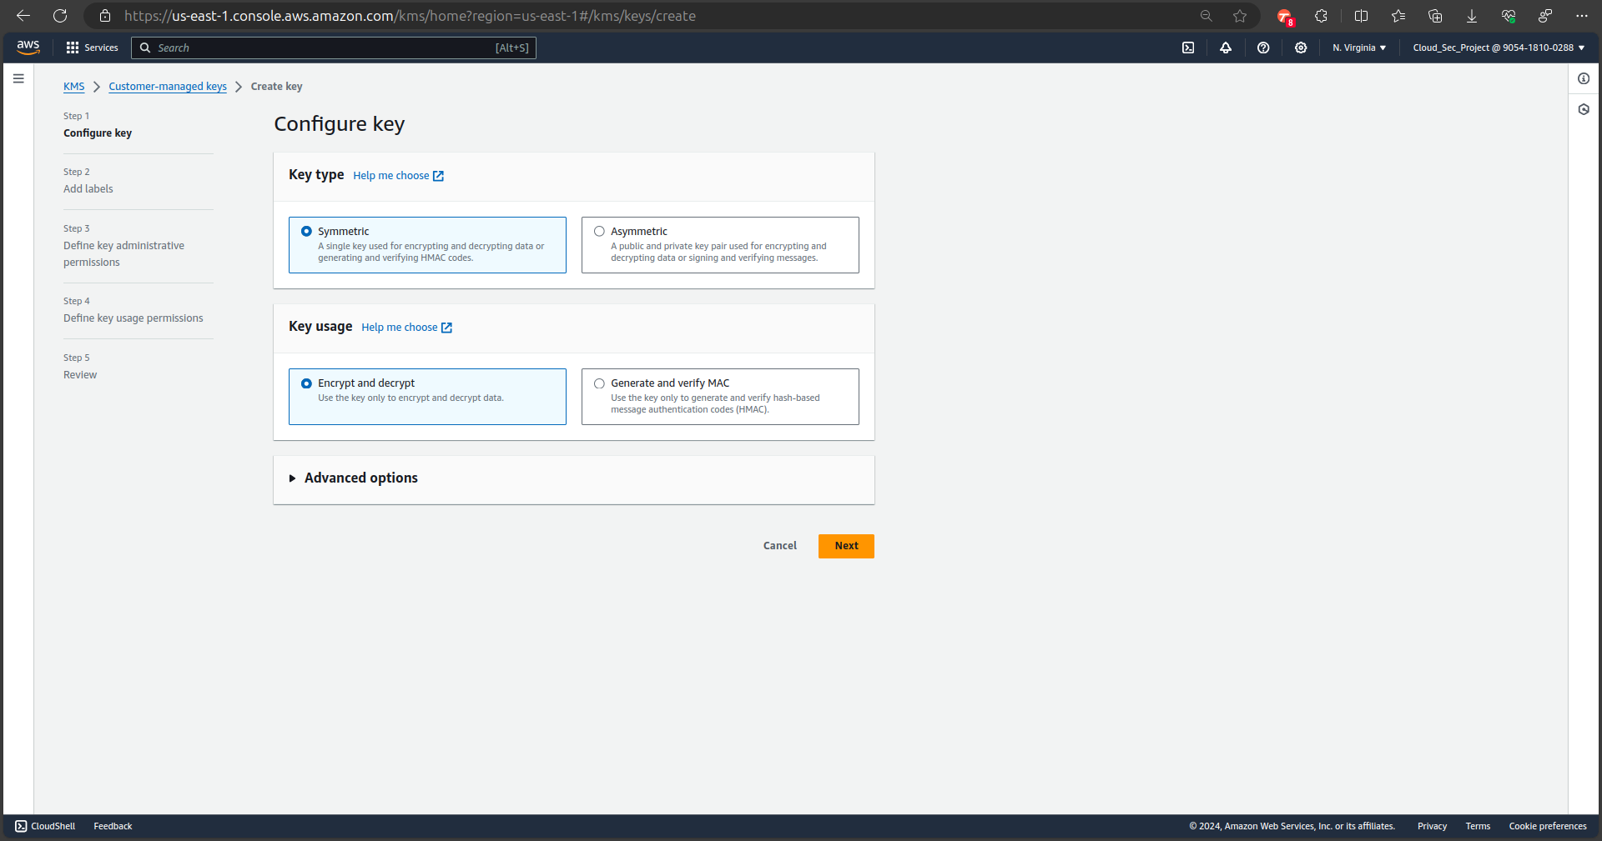
Implementing KMS

Slide 15
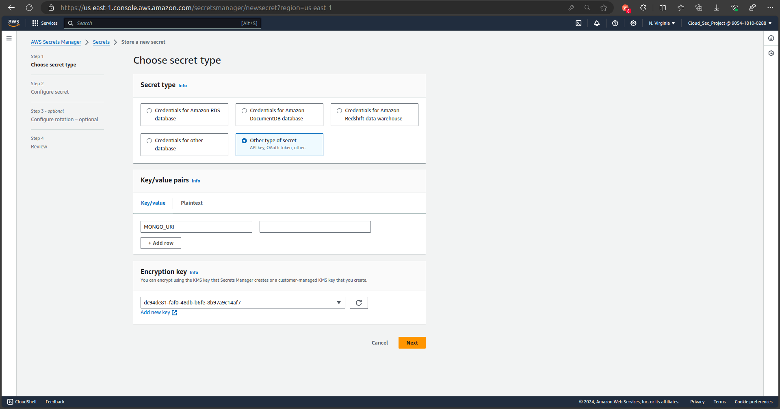
Storing Application secrets

Slide 16
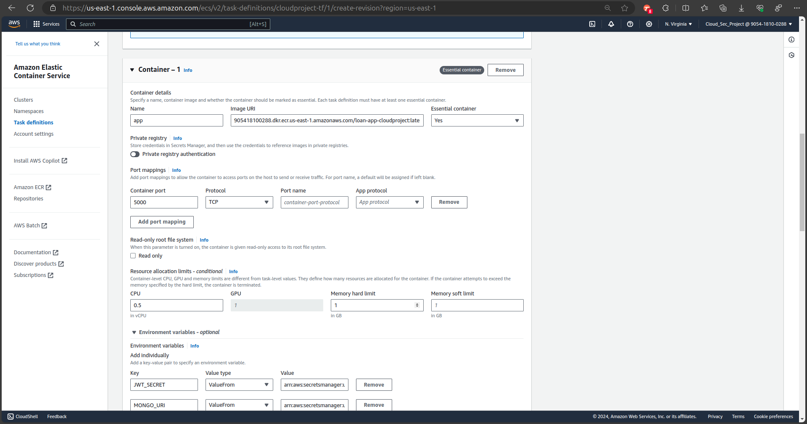
ECS setup for Application

Slide 17
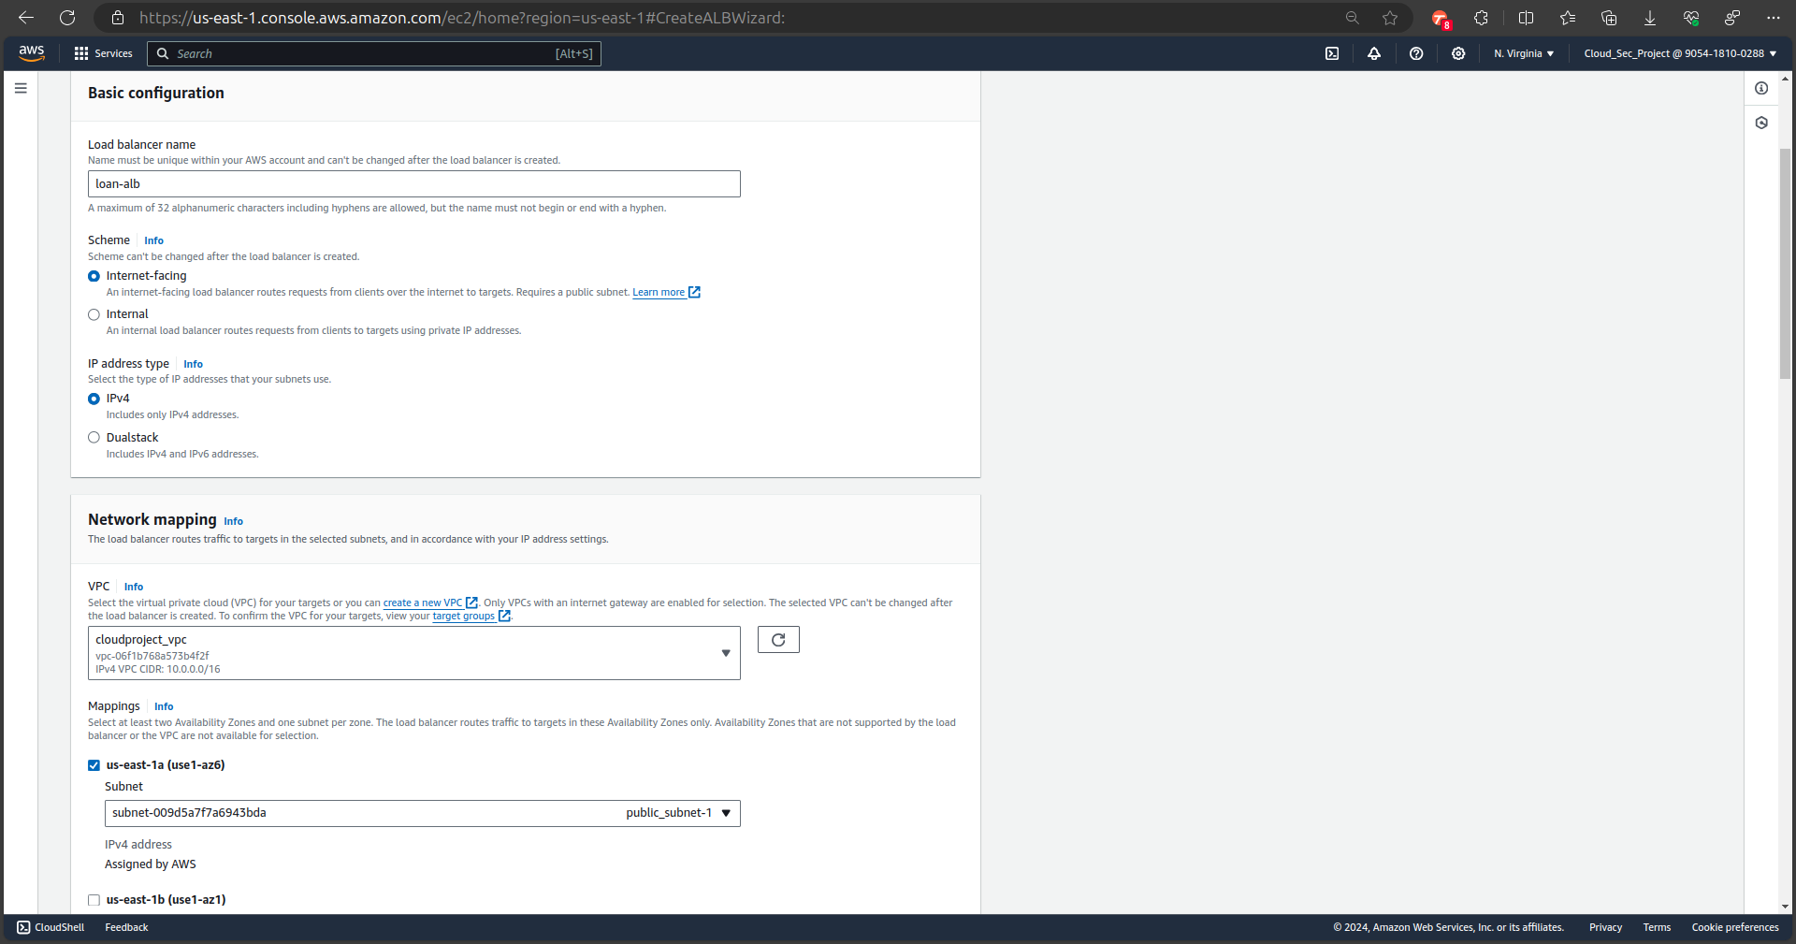
Implementing Load Balancer

Slide 18
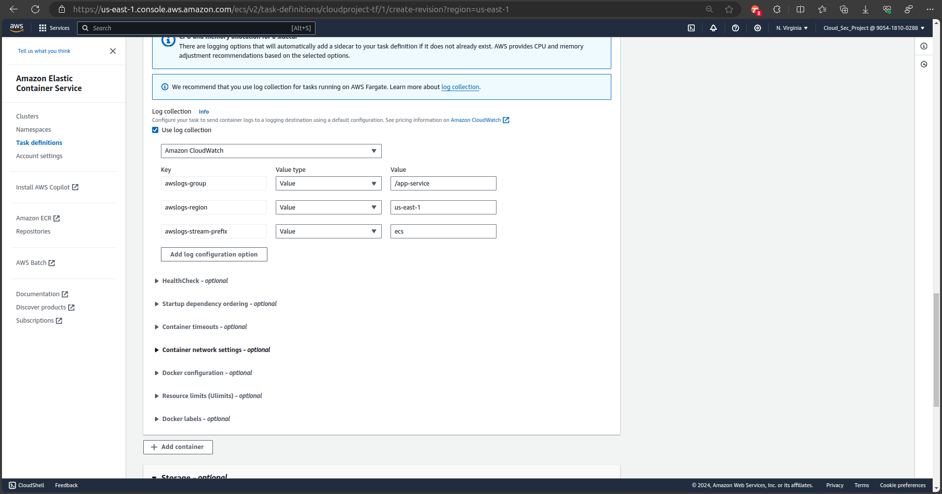
Cloud watch Logs for ECS Containers

Slide 19
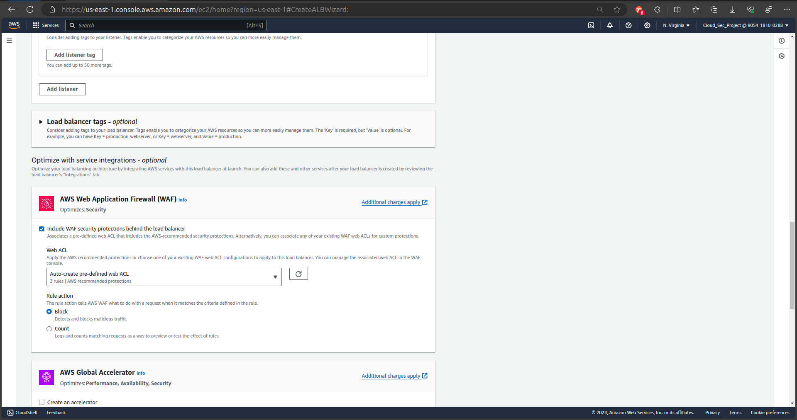
Implementing WAF

Slide 20
Conclusion
Loan Management with AWS makes the application easier to work under heavy load by implementing Load Balancer and provides seamless interaction for customers.
AWS revolutionize loan management in the financial sector by utilizing AWS MongoDB and services like ECS, ECR and WAF, since the data is confidential it is protected from unwanted threats

Slide 21

Thanks !!!!

